Slide 1
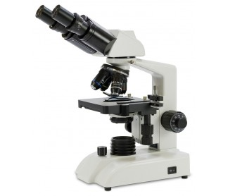
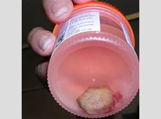
PATHOLOGY UPDATE
Dr Steve Kamiza FCPath
Dr Tamiwe Tomoka FCPath

Slide 2
TISSUE IS THE ISSUE
Background to pathology services in Malawi
Establishment of the QECH and UNC/KCH labs
Pathology: Research with emphasis on cancer
Pathology: Training, teaching and workshops
Pathology: Diagnostic service
Challenges
Future directions

Slide 3
BACKGROUND
Increasing burden of cancer in Sub- Saharan Africa.
HIV epidemic
Growth and aging of the population
Adoption of ‘westernised’ lifestyles
Scarcity of pathology services
Less than 1 pathologist/1 million population
4 + 1(retired)/16million population in Malawi

Slide 4
BACKGROUND
Before 1981 Specimens sent to St Thomas’ Hospital in the UK
1982-1995: QECH hospital
1995 to date: College of Medicine
2005 to date: Private pathology laboratory, Blantyre
2011 to date (COM/MEPI, MOH, UNC support)
UNC/KCH (2011)
QECH (2013)

Slide 6
ESTABLISHMENT OF THE UNC/KCH LAB: 2011
Collaborations between MOH and UNC
Other partners included COM/MEPI, Africa Malignancy Consortium, DAIDS
Renovation of lab space at dermatology unit and sourcing equipment: 200,000USD
Aperio Virtual microscopy system installed for long distance diagnostic and research consultation

Slide 7
ESTABLISHMENT OF THE UNC/KCH LAB: 2011
Increase in number of specimens
2011: cytology = Nil; histology: 705
2015: Cytology = 2063; Histology = 4136
Establishment of the FNA clinic
Anticipating more in 2016; to date 3400 histology
35% are malignant diagnoses
Common cancers being Cervix, Lymphoma, Kaposi sarcoma, Oesophageal and Breast in that order
Turn around time: 5 days to 2 weeks

Slide 8
Frequency of cancer (n) 2014-July 2016
TYPE OF CANCER | N
Lymphoma | 339
Cervix | 330
Kaposi Sarcoma | 295
Esophageal | 273
Breast | 173
Others | 227
TOTAL | 1637

Slide 9
ESTABLISHMENT OF THE QECH LAB: OCT 2013
College of Medicine MEPI linked award
2010 -2012: Renovation of space at QECH lab and sourcing equipment.
October 2013 lab opened
Reduction in number of specimens in BT due to opening of KCH lab from 5000/year to 3000.
Flactuating turn around times: Generally longer than Lilongwe
Range of pathology similar to Lilongwe: With exception to KS and lymphoma.

Slide 10
PATHOLOGY: RESEARCH WITH EMPHASIS ON CANCER
Both Blantyre and Lilongwe have been involved in research with numerous publications
Paediatric cancer research: Wilms and Burkitt
Cervical cancer
Breast: Emerging
Oesophageal: Emerging
Lymphoma: First ever large lymphoma cohort in Sub-Saharan Africa (Lilongwe)
Lymphoma: AIDS Malignancy Consortium Phase II trial

Slide 11
TRAINING
In the past 5 years we have made huge strides in training and teaching with support from COM, MEPI, Global fund, UNC and MOH
5 pathologists in training (4 MOH, 1 COM)
plus 2 MOH and 1 UNC now looking for placements
1 histotechnologist and 2 scientists (masters level).
1 cytotechnologist (bachelors level) and 1 cytology scientist (masters level)

Slide 12
TRAININGS
College of Medicine: Postgraduate and undergraduate teaching and research
Colleges of health sciences and other public universities: student placements in the labs
Special trainings to selected groups:
Handling of pathology specimen: both cytology and histology from patient/clinician to the lab
The FNA procedure
Clinical pathology conferences/Tumour boards

Slide 13
DIAGNOSTIC SERVICE
About 70% of the work in pathology lab is purely diagnostic service – Good source of research material.
QECH lab serves QECH, Zomba , CHAM hospitals and some district hospitals
KCH lab serves KCH, Mzuzu, CHAM, district hospitals and private hospitals in Lilongwe
Pathology overseas (Dan Milner et al) sends volunteer pathologists

Slide 14
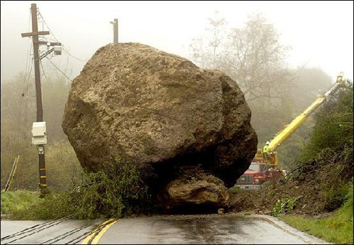
CHALLENGES

Slide 15
CHALLENGES
Sustainability of the labs: Major challenge
Both labs largely depend on research grants
No deliberate budget lines for these labs
QECH heavily affected (MEPI grant finished)
KCH being cushioned by UNC
Low staffing levels (pathologists, technologists)

Slide 16
FUTURE DIRECTIONS OF PATHOLOGY IN MALAWI
Intensifying locally generated research in cancer
Capacity building: Postgraduate/specialist training in Anatomical pathology
Establishment of fully equipped, serviced and adequately staffed pathology laboratories in all the 4 central hospitals

