Slide 1
Malawi Cancer Consortium Mentoring Activities
Satish Gopal MD MPH
University of Malawi College of Medicine
UNC Lineberger Comprehensive Cancer Center
UNC Institute for Global Health & Infectious Diseases
UNC Gillings School of Global Public Health
Malawi Cancer Symposium
30 August 2016
Lilongwe

Slide 2
Overall consortium aims
Aim 1. Develop human capacity and infrastructure in Malawi, specifically for HIV-associated cancer research.
Aim 2. Conduct high-impact basic, clinical, and epidemiologic research related to Kaposi sarcoma (KS) and lymphoma.

Slide 3
Malawi Cancer Consortium administrative structure
Consortium PIs | Satish Gopal MD MPH UNC Project, Lilongwe Clinical Research | Sam Phiri PhD MSc Lighthouse, Lilongwe Implementation Science | Blossom Damania PhD Lineberger, Chapel Hill Virology
Support Cores | Administrative Innocent Mofolo (UNC Project) Thom Chaweza (Lighthouse) Irving Hoffman (UNC Project) | Mentoring Mina Hosseinipour (UNC Project) Ron Mataya (COM) | Analysis Nora Rosenberg (UNC Project) Hannock Tweya (Lighthouse)
Research Projects | 1. HIV-Cancer Record Linkage Charles Dzamalala (COM) Kennedy Malisita (MOH) Andrew Olshan (Lineberger) | 2. Kaposi Sarcoma Agnes Moses (UNC Project) Joe Gumulira (Lighthouse) Dirk Dittmer (Lineberger) | 3. Lymphoma Bongani Kaimila (UNC Project) Richard Nyasosela (MOH) Satish Gopal (UNC Project)

Slide 4
Mentoring progress

Slide 5
Mentoring achievements
Face-to-face meetings between in-country mentors and junior investigators to discuss mentee goals and needs
Developed standardized template for career development plans across training programs at Malawi College of Medicine (COM) and other HIV training grants
Dedicated U54 mentoring/career development workshop in Lilongwe June 2015
Participation in weekly UNC Project work in progress meetings and weekly cancer group lab meetings
Grant writing workshop 2016
Identification of PhD opportunities for interested/appropriate candidates

Slide 6
Analysis achievements
Hardware/software purchases
Masters-level biostatisticians in Blantyre (Steady Chasimpha) and Lilongwe (Christopher Stanley)
Didactic analysis workshops held 2014 & 2016
Investigators entered workshop with a working dataset and research question, and through a series of weekly interactive assignments were assisted in conduct of their analyses as well as moving projects toward the manuscript writing phase
Didactic topics covered included: formulating a research question; univariate statistics and variable specification; statistical testing; measures of association; bivariate analysis; confounding; multivariate modeling; and survival analysis
Manuscript writing workshop held 2015 including U54 cancer investigators to facilitate progress and completion of ongoing projects
Regular dissemination meetings attended by key stakeholders for ongoing Lilongwe clinical research activities including presentation of results of ongoing studies
Manuscript writing retreat August 2015 to provide dedicated time and peer feedback to facilitate completion of ongoing projects

Slide 7
Other mentoring achievements
Successful Malawi AMC site competition (Moses/Chinula)
NCI DCEG/IARC relationship/involvement (Mulima/Kaimila)
Lineberger breast cancer SPORE grant support (Moses)
Strengthened UNC relationship with COM (P20 application; D43 in development)

Slide 8
Mentoring challenges
Minimizing duplication while building adequate dedicated mentoring for cancer activities
Limited laboratory/translational exposure
No prior cancer-specific training grant in Malawi
Promising Malawi cancer investigators are often very junior and need assistance moving toward terminal degrees/certifications
Finding enough people/capacity to tackle all the interesting work
Melanoma, head & neck cancer, bladder cancer, etc.
Pursuing interesting lines of inquiry without becoming too diffuse
Developing a culture of non-last-minutedness and perfectionism

Slide 9
Mentoring Challenges in Kampala
Nakanjako D, et al. (2011):
Lack of awareness of roles of mentors, mentees
Ad hoc, lack of institutional structure
Limited number of available mentors
Limited time for mentoring
Need for training of mentors
Nakanjako D, Byakika-Kibwika P, Kintu K, Aizire J, Nahwagala F, Luzge S, Namsi C, Mayanja-Kizza H, Kamya MR. Mentorship needs at academic institutions in resource-limited settings: a survey at Makerere University College of Health Sciences. BMC Med Ed 2011, 11:53-60.
Notes:
Yet, gap in mentoring resources in Uganda, and suspect many other countries in SSA.
In a terrific study published in 2011, Damalie Nakanjako (think somewhere in this room….) survey of faculty members and graduate students at Makerere College of Health Sciences (who were affiliated with Fogarty) Know that Damalie and others working at MakCHS to build instituional programs…… As we continue to do that,

Slide 10
“Top Three Values”
Teamwork (77% )
Integrity (33%)
Family (33%)
Excellence (33%)
Creativity (33%)
Marked by most but not top 3:
Achievement
Authenticity
Friendship
Honesty
Persistence
Recognition
None or 1 marked:
Fame
Power
Risk
Status
Notes:
Starts with identification of values – then goes on to identify 10 year goals and 1 years goals and steps to achieve….. (happy to share forms with anyone…..) But values process quite interesting….. Prioritize core values – 77% --- “peer mentoring” resonates with values – let trainees speak – culturally appropriate approach…
Pololi L. Career development for academic medicine—a nine step strategy. BMJ Careers, 2006

Slide 11
Consortium representation @ AORTIC 2015
Charles Dzamalala | OESOPHAGEAL CANCER IN EASTERN AFRICA
Satish Gopal | HIV & LYMPHOMA IN SUB-SAHARAN AFRICA: CHALLENGES & OPPORTUNITIES
Lily Gutnik | DISSEMINATING BREAST CANCER KNOWLEDGE AND AWARENESS IN LILONGWE, MALAWI USING LAYWOMEN
MJ Horner | RECEIPT OF CANCER CARE AT KAMUZU CENTRAL HOSPITAL IN MALAWI: A HOSPITAL-BASED CANCER REGISTRY STUDY
Bongani Kaimila | CHARACTERISTICS AND SURVIVAL FOR HIV-ASSOCIATED MULTICENTRIC CASTLEMAN DISEASE IN MALAWI
Coxcilly Kampani | COLLABORATIVE TELEPATHOLOGY ENHANCES DIAGNOSIS OF LYMPHOPROLIFERATIVE DISEASES IN MALAWI
Shiraz Khan | UTILISATION OF FINE NEEDLE ASPIRATION AT KAMUZU CENTRAL HOSPITAL
Kelly Koher | BREAST CANCER KNOWLEDGE AND PREFERENCES IN MALAWI: IMPLICATIONS FOR EARLY DETECTION INTERVENTION FROM A DISCRETE CHOICE EXPERIMENT
Agnes Moses | PREDICTORS AND DISTRIBUTION OF COMMON CANCERS AT KAMUZU CENTRAL HOSPITAL, LILONGWE, MALAWIS FROM A DISCRETE CHOICE EXPERIMENT
Christopher Stanley | PREDICTORS OF ONE YEAR SURVIVAL AMONG CHOP-TREATED CHILDREN WITH ENDEMIC BURKITT LYMPHOMA IN LILONGWE, MALAWI
Notes:
At the recent big Africa cancer meeting, we had strong representation from our group, essentially all of whom attended for the first time, presented their own work, and participated in pre-conference young investigator workshops conducted by NCI Center for Global Health.

Slide 12
Pilot grants
Developed an RFA for our pilot grant program modeled after the R25 UJMT Fogarty Global Health Fellows Program (PI Ben Chi)
Four $10,000 pilot grants awarded November 2015
External review by non-U54 UNC faculty with NIH-style scoring, comments, revisions
Important mechanism for extending core U54 scientific work
Bongani Kaimila | Assessing HIV and other risk factors for esophageal squamous cell carcinoma in Malawi
Lameck Chinula | Acceptability of a community-based cervical cancer screening and HIV testing campaign in a rural area of Lilongwe district, Malawi
Agnes Moses | HIV Infection and Breast Cancer in Malawi
Christopher Stanley | Assessing the Impact of HIV on Loss to Follow-up and Survival among Children with Lymphoma in Malawi
Notes:
We competed and awarded pilot grants last year modeled after Ben Chi’s Fogarty Global Health Fellowship program, and these projects are being implemented now. All applicants uniformly described the grant application process as very helpful, for most the first time they were writing a grant and receiving external review, and now the first time they’re leading regulatory approvals for their own studies with their own money.

Slide 13
Key Malawi cancer investigators
Investigator | Training | Location | U54 responsibilities | Interests
Malawi
Agnes Moses | Internist | Lilongwe | KS co-leader; pilot grant awardee | KS, breast cancer
Lameck Chinula | OB-GYN | Lilongwe | Pilot grant awardee | Cervical cancer
Christopher Stanley | Biostatistician | Lilongwe | Analysis unit staff; pilot grant awardee | Pediatric cancer
Bongani Kaimila | Medical officer | Lilongwe | Lymphoma co-leader; pilot grant awardee | Esophageal cancer
Richard Nyasosela | Clinical oncologist | Lilongwe | Lymphoma co-leader | HPV-associated cancer, HCC
Joe Gumulira | Clinical officer | Lilongwe | KS co-leader | KS
Steady Chasimpha | Biostatistician | Blantyre | Record linkage co-leader | Cancer registration
Tamiwe Tomoka | Pathologist | Blantyre |  | Lymphoma
Reginald Chunda | OB-GYN | Blantyre |  | Cervical cancer
Albert Mwafongo | Medical oncologist | Lilongwe |  | KS, lymphoma
Gift Mulima | Surgeon | Lilongwe |  | Esophageal cancer
Vanessa Msosa | Surgeon | Lilongwe |  | Breast cancer
US
Kelly Kohler | Health systems researcher | Boston |  | Breast, cervical cancer
Kate Westmoreland | Pediatric oncologist | Lilongwe | Pediatric lymphoma leader | Pediatric cancer
Lily Gutnik | Surgeon | New York |  | Breast cancer
MJ Horner | Epidemiologist | Lilongwe | Record linkage co-leader | Cancer registration, etiology
Matt Painschaub | Medical oncologist | Chapel HIll
Nate Montgomery | Hematopathology | Chapel Hill | Lymphoma co-investigator | Lymphoma
Notes:
This all brings us to trying to slowly build a team, and I think through our U54 consortium, we’ve identified a nice group of both junior US and Malawian investigators with career interests in global cancer research. After Kelly Kohler, MJ is now making excellent progress toward what will officially be the second UNC PhD from the Malawi cancer program, and Bongani recently interviewed with the Malawi College of Medicine program to hopefully complete requirements for his PhD studying esophageal cancer with us. So we have a program that can increasingly accommodate career development needs of both US and Malawian trainees which is exciting.

Slide 14
Funding opportunities
NIH (Fogarty K43)
Cancer foundations (ASCO, ASH, LLS, ACS, Komen)
IARC/UICC
AORTIC/BIG CAT
UJMT Fogarty Global Health Fellows Program
U54 MCC pilot grants

Slide 15
Questions?

Slide 16
Malawi P20 NCD Center of Research Excellence Planning Discussion
Satish Gopal MD MPH
University of Malawi College of Medicine
UNC Lineberger Comprehensive Cancer Center
UNC Institute for Global Health & Infectious Diseases
UNC Gillings School of Global Public Health
Malawi Cancer Symposium
30 August 2016
Lilongwe

Slide 17
P20 RFA
First round: 10 Dec 2015
Second round: 23 Aug 2016
Sponsor: US National Cancer Institute Center for Global Health
Award: 400,000 USD over 2 years (September 2016-August 2018)

Slide 18
P20 RFA continued
The goal is to support sustainable RCREs that will:
1) strengthen scientific quality and volume;
2) boost collaboration;
3) fortify the scientific shared core facilities;
4) enhance research activities; and
5) provide the scientific evidence needed to inform public policy to create a sustainable model empowering LMIC institutions.
At least one of the NCD-related problems identified for research support under this award must be cancer-focused. The plans produced during these P20 awards will provide a plan for a RCRE that may be supported by a future FOA.
The RCRE Planning Grants will create a network that will develop, share, evaluate, and disseminate best practices, guidelines, standard operating procedures, and data within the LMIC NCD research community.

Slide 19
P20 RFA continued
At the end of the planning grant, successful awardees will have produced a plan, including:
a completed local needs assessment that includes documented community engagement;
a well-conceived research plan that specifies the short-, mid-, and long-term outcomes of the research program;
the projected impact of the research on the region;
a multidisciplinary research enhancement activity plan that will support the proposed research programs by providing appropriate enrichment options including but not limited to courses, laboratory experiences, enhanced mentoring, etc.;
a well-justified plan for consolidating existing or opening new shared core facilities; and
concrete metrics for monitoring and evaluating the quality, value, and scientific impact of the RCRE.
At the end of the grant period, the awardees will have demonstrated an ability to undertake successful collaborative research by completing at least one small joint NCD-focused research project of relevance to the LMIC investigators.
These plans will be disseminated widely by the NCI in a special publication.
Selected RCRE planning grant recipients will be visited to provide clarification and evidence of their RCRE plan.

Slide 20
Malawi P20 Application Scientific Review
Impact score 17 (range 10-90)
Selected comments
The country has made significant progress building communication and information technology capacity, as well as creating a cancer registry, adding strength to the overall environment and bolstering confidence in the prospects for success of this high-risk venture.
The overall goal is highly significant, given the relative lack of NCD research infrastructure in Malawi. The choice of cancer, injury, and cardiovascular disease (CVD) as research foci is reasonable, and three pilot projects are proposed in these areas.
This application builds on a very strong infrastructure developed by the University of Malawi in collaboration with UNC and other institutions. The team has worked hard to obtain the participation of a large number of institutions with a focus on NCDs.
This application has some moderate weaknesses:
1) the initial focus on cancer, injury prevention and CVD may be too broad for a two year effort;
2) the approach seems quite generic, with few innovative approaches to build collaborations across institutions;
3) little information is provided on the injury or CVD efforts.

Slide 21
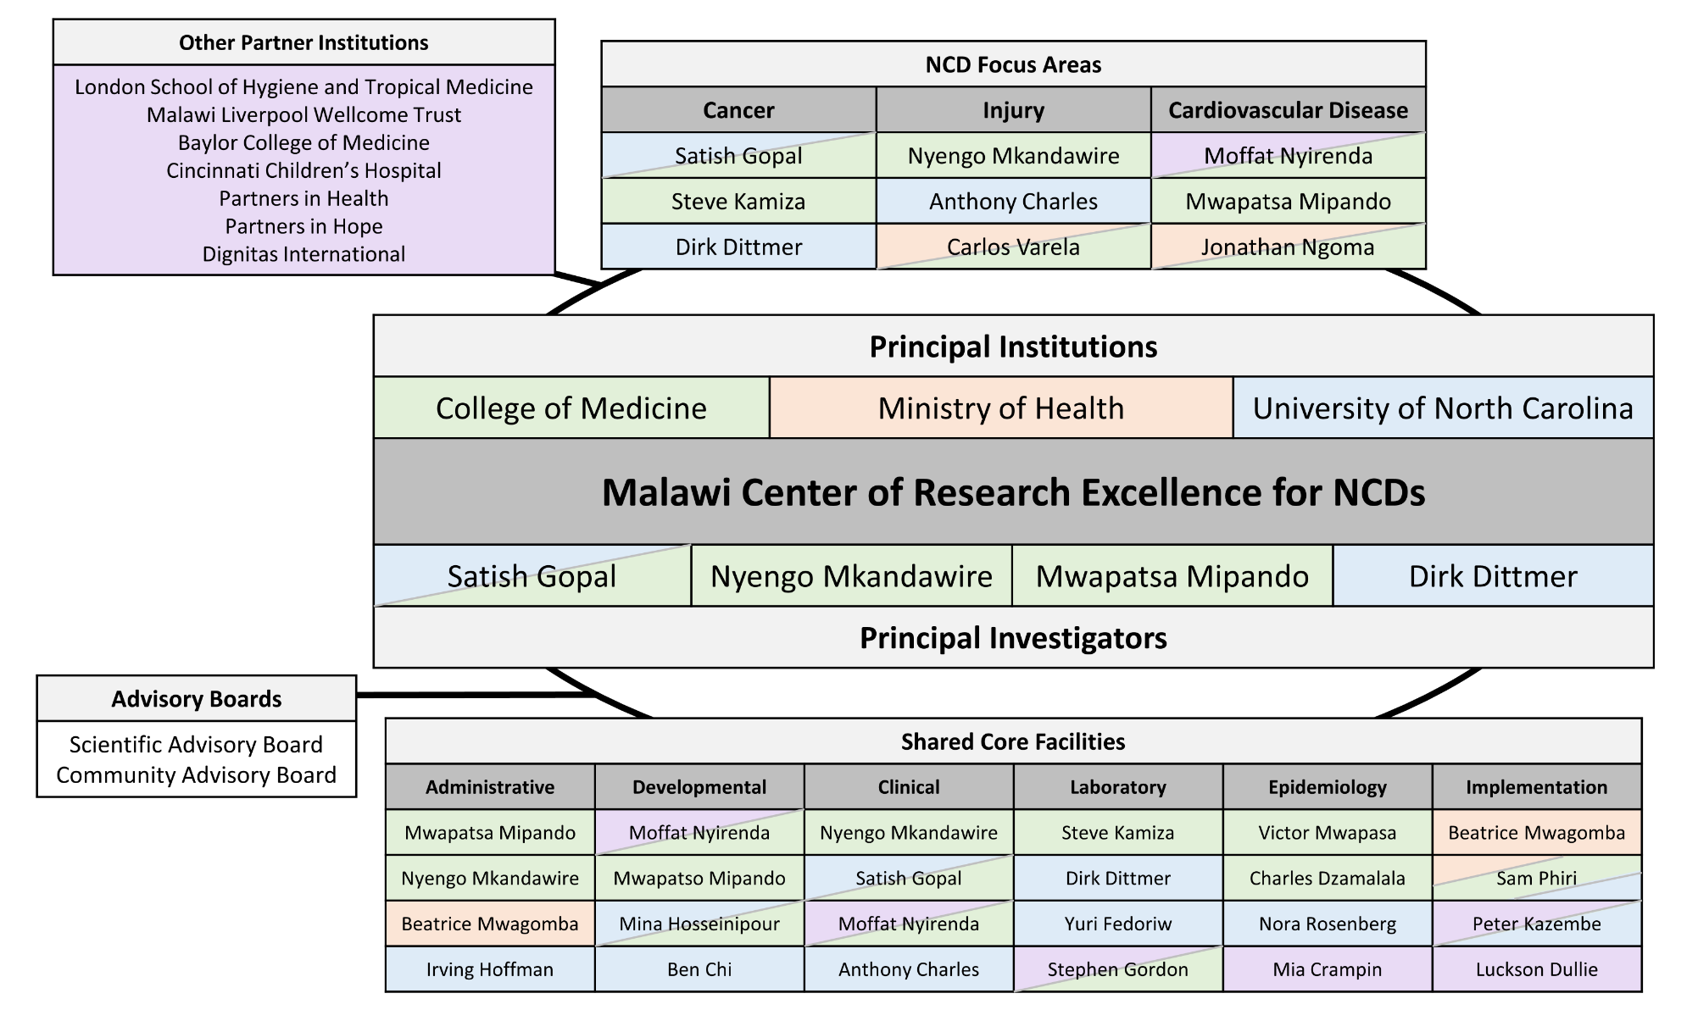
NCI P20 Malawi NCD Center of Research Excellence structure
Notes:
Using our U54 consortium success as a foundation, we also recently successfully competed for an NCI P20 planning grant to establish a Malawi center of research excellence for non-communicable diseases, including even more partners and even more disease topics apart from cancer, as if we didn’t have enough to do already. But this is really exciting for all of us, and importantly includes injury as a key focus area apart from cancer, building on strengths of the UNC and Malawi College of Medicine surgery programs in Lilongwe and Blantyre, respectively. Professor Nyengo Mkandawire who is the head of the surgery department at the College of Medicine as well as the College principal Mwapatsa Mipando serve as Malawian co-PIs for this program, and we hope to have our first stakeholder discussions at the end of August after I’m back in Malawi, at a time that should overlap with Anthony’s upcoming visit.

Slide 22
Timeline and Milestones | Year 1 |  |  |  | Year 2
 | Q1 | Q2 | Q3 | Q4 | Q1 | Q2 | Q3 | Q4
Coordination
Execute COM subcontract, disburse funds to Malawi
Convene grant support staff at UNC/COM, assign responsibilities
Arrange communication, set-up conference calls and email groups
Assemble community engagement committee, identify key groups for engagement
Community engagement meeting (alternating between Lilongwe and Blantyre)
Assemble planning committee for NCD partner meeting, organize meeting
NCD partner meeting (alternating between Lilongwe and Blantyre)
Prepare and disseminate overall progress report
Develop overall application structure, plan, and writing teams for RFA to follow P20
Research
Identify one-year multi-institution mentored pilot projects in each NCD focus area
Convene research teams and develop research strategy
Conduct mentored pilot projects led by Malawian junior investigators
Disseminate results of mentored research projects
Shared core facilities*
Convene core facility groups, assign responsibilities
Survey current Malawi resources and prioritize needs
Conduct monthly core facility conference calls
Prepare and disseminate core facility progress reports
Develop core facility structure, plan, and writing teams for RFA to follow P20

Slide 23
Questions

Slide 24
Stakeholder introductions & NCD activities updates

Slide 25
Way forward?
Community engagement
Needs assessment
Communication
Pilot projects
NCD partner meeting
Shared core facilities
Workplan and timelines

