Slide 1
Reducing the burden of cervical cancer
Dr Reynier Ter Haar
Mrs Beatrice Kabota
Nkhoma Hospital and University of Edinburgh

Slide 2
Aim
To explain Nkhoma “hub and spokes” model
Provision of a ‘see and treat’ programme of cervical screening,
To present Thermal coagulation as a treatment alternative

Slide 3
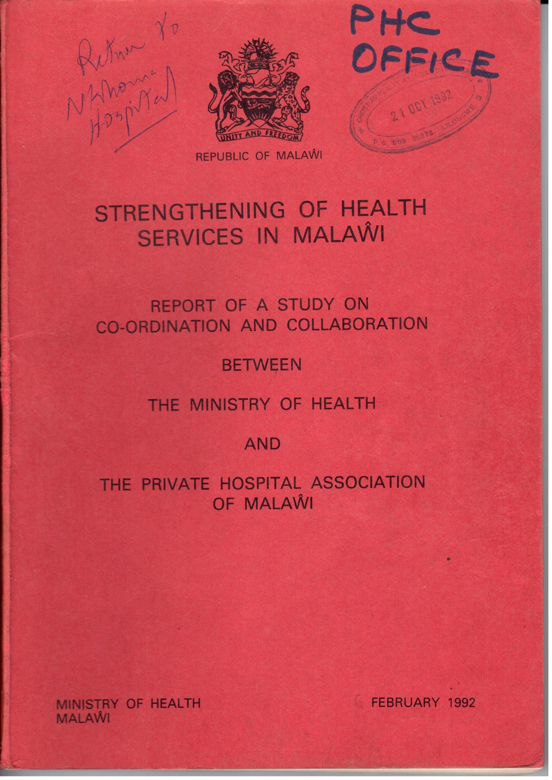

Slide 4
Health delivery areas

Slide 6
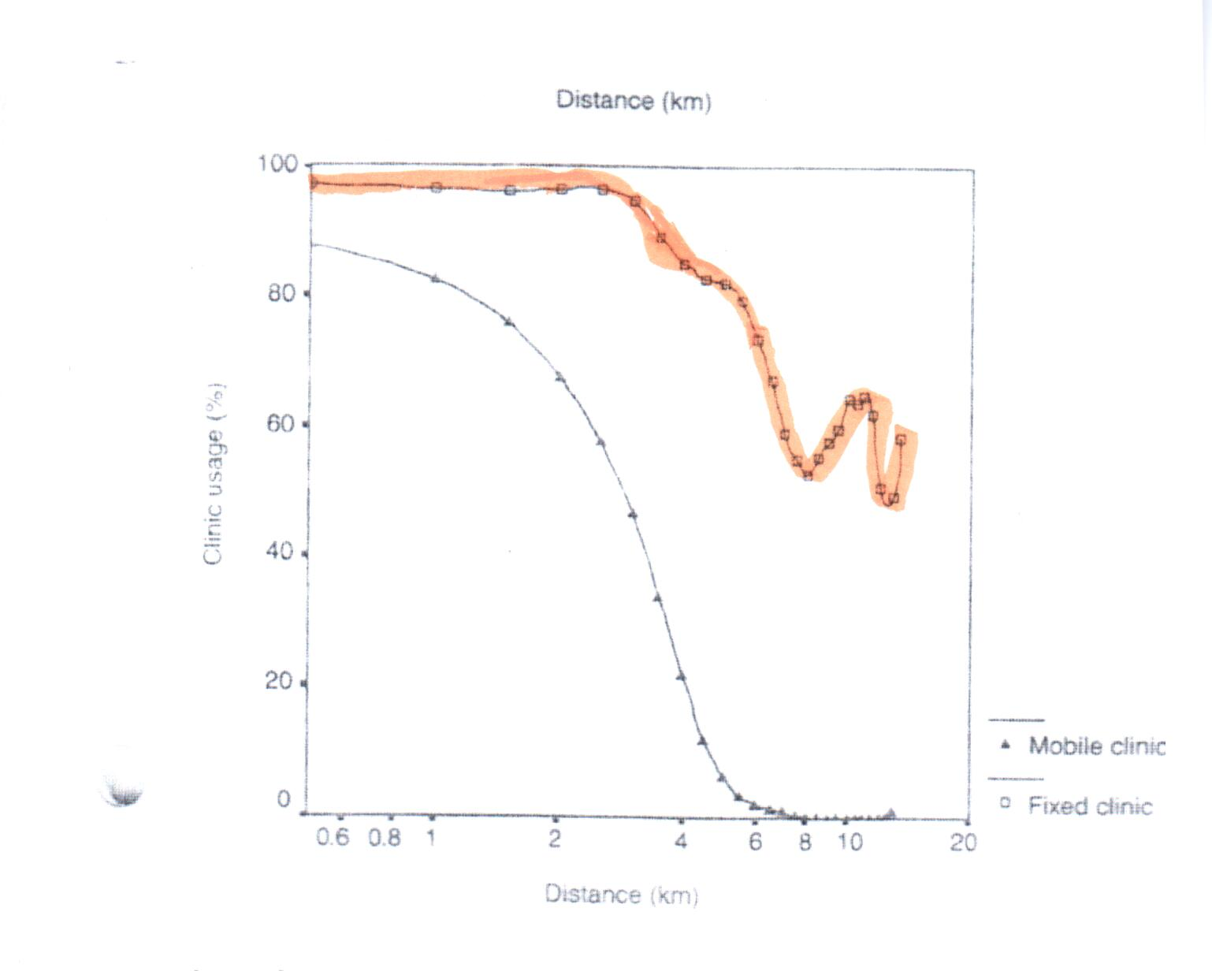
Clinic usage decline after distance of greater than 4.72km

Slide 7
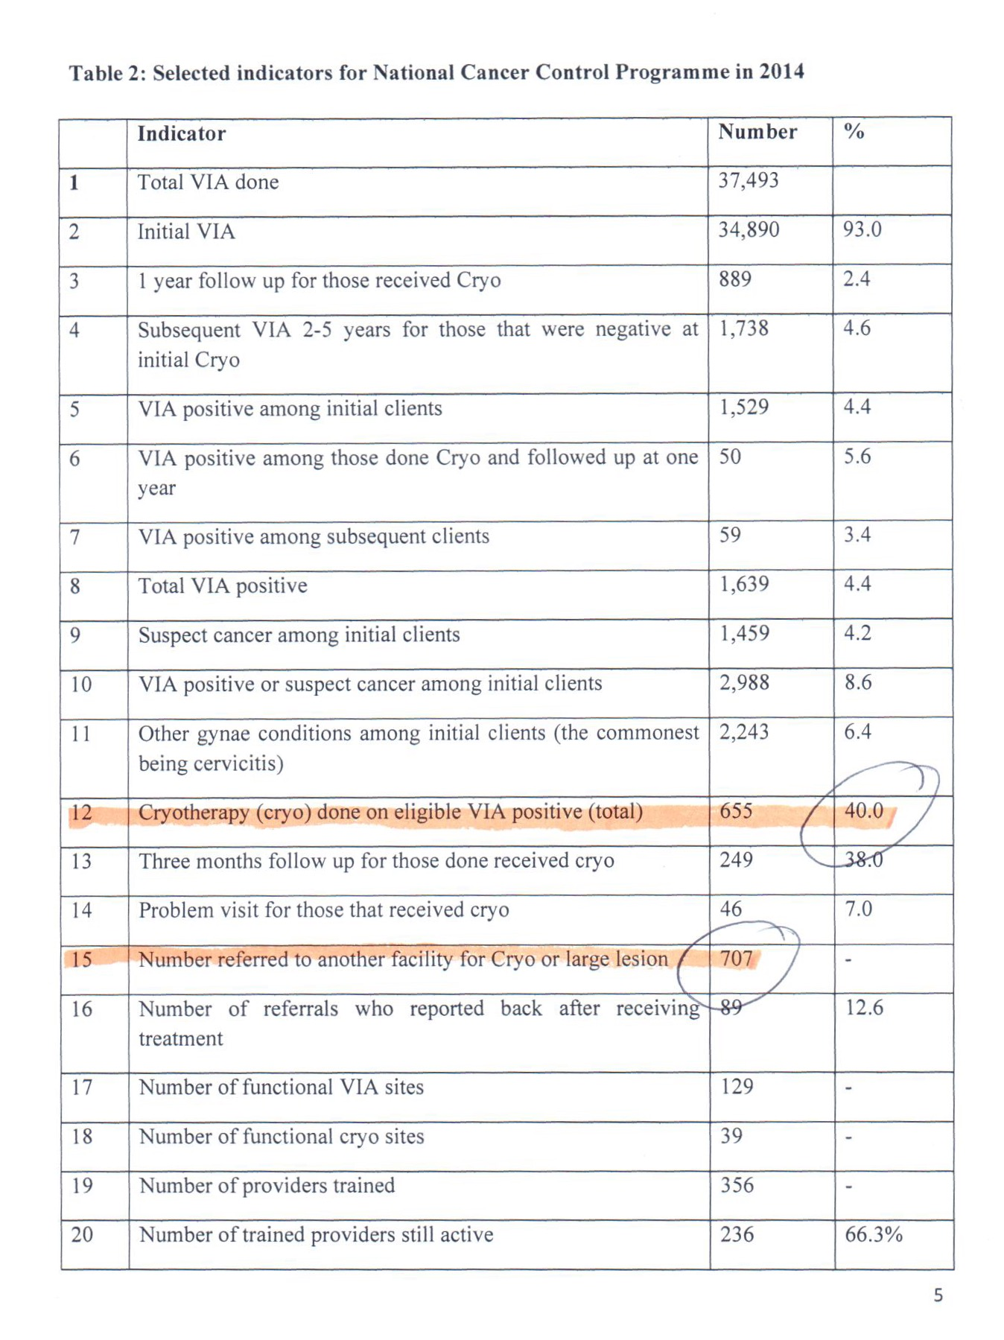
VIA positive
40% treated
VIA positive
60% NOT TREATED

Slide 8
Introduction
The incidence of cervical cancer in Malawi is the highest in the world
The age-standardised incidence rate is 75.9 per 100,000 women in all age groups combined (Afr-Dev 2014).
The Malawian Ministry of Health supports screening using visual inspection with acetic acid (VIA)
However, screening provision is often limited due to lack of infrastructure and trained personnel, cost and availability of gas for cryotherapy(2014 report,only 40% treated)

Slide 9
Introduction conti…..
A WHO demonstration pilot in sub-Saharan Africa (WHO 2012), including Malawi, provided single-visit screen and treat for 39% of clients on the same day.
However, a similar proportion of clients eligible for cryotherapy did not receive treatment: reasons included equipment not being in working order at the time, and clients requiring to get consent from their spouses for cryotherapy
There is increasing evidence that thermal coagulation is a safe and effective alternative to cryotherapy.

Slide 10
How can we reduce cancer of the cervix?
Education of the people
Nutrition of the people
Identify HIV and offer HAART
Screen with VIA
Treat VIA positive lesions

Slide 11
PRE-INVASIVE CERVICAL LESION Treatment options
OBSERVATION:
Only for low-grade lesions or pregnant women.
ABLATIVE THERAPY:
Electrocautery/ Thermal Coagulation.
Cryotherapy.
Laser ablation
RESECTION TREATMENT:
Cones: LEEP, cold laser.
Hysterectomy for selected cases.

Slide 12
Thermal coagulation
Thermal coagulation is an ablative treatment for pre cancer cervical lesions
Thermal coagulation commonly known as cold coagulator uses the metallic probe that destroys cells at high temperatures (100- 120ºC).
Developed by a scientist called Kurt Semm

Slide 13
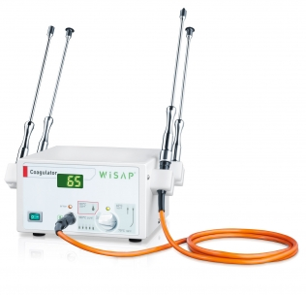
Examples of Thermal coagulators

Slide 14
Probes

Slide 15
Attractive features of thermal coagulator
The time for treatment procedures is short, typically 30-45 seconds.
The machine is small and portable (weight = 3.6kg)
The low electricity running requirements mean the cost over time is small and cheaper than cryotherapy
Use of the thermal coagulator allows punch biopsies of suspicious lesions to be taken in the screening clinic. This results in both time and money savings for both the patient and the health facility.
Probe can be applied more than once to treat a large lesion

Slide 16
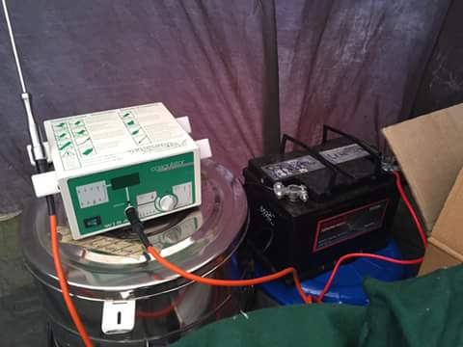
New developments - battery power for thermal coagulators
Demonstrating prototype of battery-powered coagulator
Using car battery to power Wisap coagulator in Tsoyo

Slide 17
Evidence for effectiveness of thermal coagulation
Thermal coagulation has been used for treatment of low grade cervical lesions since the early 1980s in UK,
PATH, concluded that thermal coagulation rated well against criteria such as efficacy and safety, suitability for use by low- to mid-level health care providers, low training requirements, general anaesthesia not required, and a short procedure time.
A recent systematic review and meta-analysis of effectiveness of thermo-coagulation from 13 studies shows a cure rate for CIN1 and CIN2-3 at 96.0% (95% confidence interval (CI)CI 92-99%) and 95.0% (95%CI 92-98%) (Dolman et al, 2014).

Slide 18
Evidence Continue….
A global leader in cervical cancer screening, Dr Sankaranarayan of IARC supports and promotes use of thermal coagulation in low and middle income countries (LMICs).
publications over the last few decades show treatment efficacy for over 90% of lesions, with no impact on fertility and subsequent outcomes of pregnancy.
Nkhoma evidence has been published in International journal of cancer (May 2016) http://onlinelibrary.wiley.com/doi/10.1002/ijc.30101/abstract
Currently, there is an upsurge in interest in thermal coagulation in several areas of the UK and beyond.

Slide 19
Use of thermal coagulation in Malawi
Thermal coagulator was introduced in Malawi in October 2013 at Nkhoma Hospital and surrounding health centres
Two years into the programme, much progress has been made towards establishing effective and sustainable screening provision.
The purpose was to introduce thermal coagulation for treatment of low grade lesions because of inconsistent supply and cost of CO₂ gas within a comprehensive cervical screening programme based on VIA.
Detailed planning was undertaken for VIA clinics, approvals were obtained from the MoH, Regional and Village Chiefs. Educational resources were developed.

Slide 20
Conti…..
Over 15,000 women who had never previously has been screened October 2013 to March 2016.
Screening clinics are done daily in the hospital and weekly in the Health Centres.
Overall VIA positivity is 6.1%, with > 80% of women receiving same day thermal coagulation treatment in hospital clinics.
94% VIA negative at 6 months review.
By March 2016, 1 year follow up post thermal coagulation were 232, and 18 were + (7.6%) were still VIA. ( N= 381 VIA+ treated by march 2015, 149 loss of follow up) 60.9 % had their 1 year follow up visit.

Slide 21
Cost-effectiveness of thermal coagulation
No formal cost-effectiveness study has been published
However, Nkhoma experience illustrates clearly accumulating benefits overtime of purchase of thermal coagulation
Pain/discomfort(n = 113)
No pain = 16%
Minimal pain = 78.8%
Severe pain = 5.3%

Slide 22
VIA outcomes according to HIV status
VIA result | HIV positive on ART HIV | HIV positive No ART | HIV Negative | HIV Status unknown | Total
VIA + | 33 | 7 | 203 | 186 | 429
VIA - | 316 | 65 | 3070 | 3637 | 7088
% VIA positive | 10.4 | 10.8 | 6.6 | 5.1 | 6.1

Slide 23
Case study from Nkhoma Hospital;
Cost of thermal coagulator and probes 3150 EUR/US$3600 suitable for thousands of treatments
This compares to approx. 600,000 Kwachwa (£870 / US$1350) for cryogun PLUS 400,000 Kwachwa (£600 / US$930)/gas cylinder (where average no. of treatments = 15)
Costs savings are made after approximately 50 women have been treated with the thermal coagulator
After that, maintenance costs are low: with care, the machines and probes will last many years

Slide 24
Other facilities in use of thermal coagulator
Kasina H/C, Deayang Luke, Katawa Clinic, 7 PIH and QECH.
With intension to lend one to Bwaila
In view of its spread, training manual for thermal coagulator is in developmental stage

Slide 25
Thermal coagulation Dataset/user testing
Additional information suggested:
6 months and 1 year review after treatment and outcome
Thermal coagulation experience from the client after treatment ( 1- No pain, 2 slight pain, 3- severe pain)
Problem visit (specify no of days since treatment, findings and management provided)
Health passport updated (yes/No)

Slide 26
Conclusion
We have learnt that effective implementation requires comprehensive training and provider support, ongoing competency assessment, quality assurance and improvement audit.
The choice of thermal coagulation enables see and treat approach to be possible in secondary prevention against cervical cancer, even at Health centre level.

Slide 27
Thank you
All

