Slide 1
Overview of Paediatric Oncology in Malawi
Peter Wasswa MBCHB, MRCP, MRCPCH, FRCPath
Consultant Paediatric Haematologist Kamuzu Central Hospital
Assistant Professor of Pediatrics
Baylor College of Medicine
Director, Malawi program, Global Hematology Oncology Programs of Excellence, Texas Children’s Hospital.

Slide 2
Overview
Significance of childhood Cancer- How common, How important?
Resources in Malawi- diagnostic, treatment- curative and supportive, including palliation
Research infrastructure- what has been done, what is being done, what is planned, opportunities,

Slide 3
GLOBOCAN 2012
14067.9 (X10³) new cancer cases
8201.6 (X10³) cancer deaths
18.5% risk of a cancer diagnosis before age 75 years)
Risk of dying from cancer at age <75 yrs. 10.5%

Slide 4
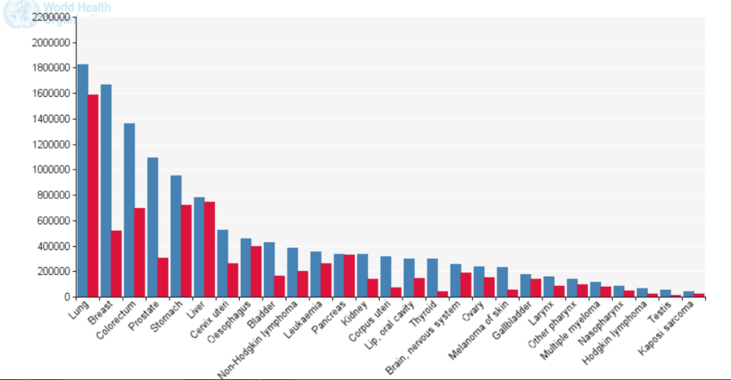
Globocan 2012

Slide 5
Cancer incidence by age group GLOBOCAN 2012

Slide 6
Child statistics 0-14yrs
0-14yrs: 163284 (1.1% of all new cases worldwide)
64% in LMIC

Slide 7
High Vs LMIC

Slide 8
Cancer subtypes 0-14yrs- World
Type | numbe | %
Leukae | 49,752 | 30.4
brain | 20,105 | 12.3
NHL | 16,514 | 10.1
Kidney | 9,656 | 6
Hodgkins | 6,744 | 4
Liver | 3,529 | 2.2
KS | 2,163 | 1.32
Thyroid | 1,715 | 1
NPC | 1,204 | 0.7

Slide 9
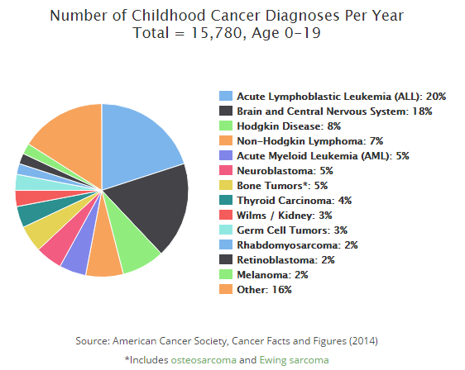
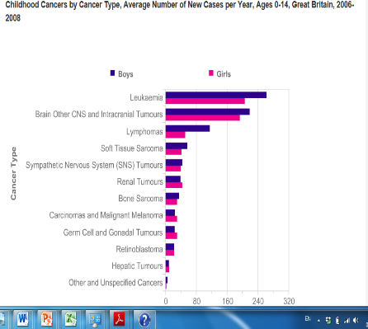

Slide 10
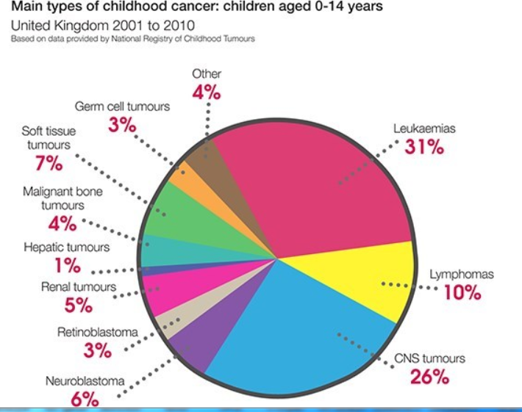

Slide 11
Cancer subtypes 0-14, GLOBOCAN 2012
Sub-Saharan Africa
Malawi

Slide 12
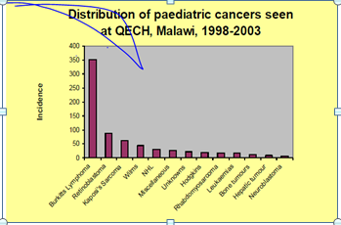
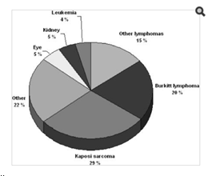
0-14 Years Kyaddondo County, Uganda 1993-1997
Blantyre

Slide 13
Why is it different for SSA?
Genetics
Environmental
Social Economic
Superfluous- diagnostic challenges
Incomplete data collection/registries

Slide 14
Childhood cancer incidence in South Africa, 1987 – 2007 Stefan etal S Afr Med J 2015

Slide 15
Leukaemia as a proportion of Ethnicity specific cancer incidence rates RSA

Slide 16
What we see at KCH
12/ 2011- 06/2013
07/2015 to 07/2016

Slide 17
GLOBOCAN 2012 DATA
07/2015 to 07/2016

Slide 18
Rationale for splitting adult and paediatric cancer services
Childhood cancer is rare
Different incident/prevalent cancer subtypes
Better outcomes for children in paediatric environments
Differences in physiology, physical and mental growth
Unique psycho-social, and educational needs for children
Late effects more significant.

Slide 19
QECH- Blantyre
Child cancer treatment since 1964
17 beds
Dr George Chagaluka-Paediatric Oncologist, resident, Clinical officer
5 nurses
Play lady
Social worker
Data manager

Slide 20
QECH resources
Paediatric surgery
Neurosurgery
Paediatric subspecialties
Pathology
Radiology- MRI
Blood bank
Palliative care

Slide 21
KCH-1
Paediatric Haematologist
2 medical officers
4 clinical officers
2 nurses + 1
UNC lymphoma study staff.
Increased scope from July 2015
Paediatric Surgeon 2016
More to come!

Slide 22
KCH- resources
General Paediatrics and retrovirology
Pathology services KCH + UNC lab + Baylor
Paediatric Surgery
Radiology- CT
Intensive Care
Blood Bank
Dietetics
Pharmacy

Slide 23
Outcomes
KCH data, Dec 2011 to June 2013; Sustained CR: (74/271 (27%) (median follow-up 19 months) Mtete et al 2015
BL 18month OS: 29% (95% CI 18-41%) Stanley et al BJH 2016
Lymphoma, Leukaemia, Wilms, Retinoblastoma contribute 83% of new non KS childhood cancer diagnoses (KCH data July 2015 to June 2016)

Slide 24
Obstacles
Late presentation
Limited diagnostic resources.
Supportive care limitations
Limited specific treatment options
Psycho social support
Treatment abandonment
Sustainability

Slide 25
Bridging the gap
Local and International partners- MOH, Newcastle, World Child Cancer, BCM, UNC
Care and research
Human resource capacity and training
Diagnostic infrastructure- flow cytometry , IHC, etc
BL new treatment strategies- HD MTX
80% CR rates for ALL, all maintained at >6months, Safe navigation of AML induction
Radiotherapy

Slide 26
Conclusion
Significant numbers of childhood cancer in Malawi
Mostly curable cancers
Poor outcomes
Opportunities to do better
The future looks bright.

Slide 27
Any questions?
Thank you
Questions

