Slide 1
Palliative Care
Paula Ward
RGN, Palliative CNS,
Nurs Dip, BSc Nurs, PGDIP Palliative care
UNC Lilongwe

Slide 2
WHO definition of Palliative Care (2002)
Palliative care is an approach that improves the quality of life of patients and their families facing the problem associated with life-threatening illness, through the prevention and relief of suffering by means of early identification and impeccable assessment and treatment of pain and other problems, physical, psychosocial and spiritual.

Slide 3
Palliative care
Palliative care is more than just pain relief
It includes addressing the physical, psychosocial and emotional suffering of patients with life threatening illness and supporting the family providing care to a loved one
About one third of those needing palliative care suffer from cancer

Slide 4
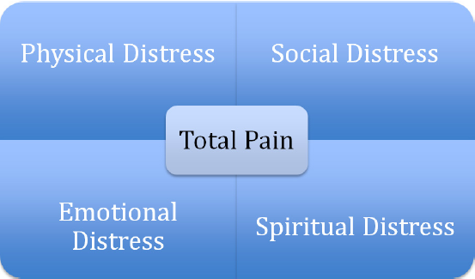
Total Pain

Slide 5
Palliative Care
While still a relatively new speciality to modern healthcare, it is increasingly recognised as an essential part of all healthcare systems
Despite this, it is widely acknowledged that there is still inadequate access to hospice and palliative care worldwide

Slide 6
World Health Assembly resolution WHA67.19
The first ever global resolution on palliative care in 2014
Called upon WHO and Member States to improve access to palliative care as a core component of health systems, with an emphasis on primary health care and community/home-based care
While recognizing that the limited availability of palliative care services in much of the world leads to great, avoidable suffering for millions of patients and their families

Slide 7
Why palliative care
Enhances quality of life and may positively influence the course of illness
Is applicable early in the course of illness, in conjunction with other therapies that are intended to prolong life such as chemotherapy or radiotherapy
Affirms life and regards dying as a normal process

Slide 8
Why palliative care
Integrates the psychological and spiritual aspects of patient care
Offers a support system to help patients live as actively as possible until death
Provides relief from pain and other distressing symptoms

Slide 9
Global Provision of Palliative Care
136 of the world’s 234 countries (58%) now have one or more hospice-palliative care services established
Malawi falling in the Preliminary integration category
Only 8.5% countries (20) have “Advanced integration’ of palliative care services
WPCA report Mapping Level Development 2011

Slide 10
Global Provision of Palliative Care
Each year, an estimated 40 million people are in need of palliative care, 78% of them people live in low- and middle-income countries.
Worldwide, only about 14% of people who need palliative care currently receive it.
WHO, 2015

Slide 11
Global Cancer Burden
Cancer is a leading cause of death worldwide, accounting for 8.2 million deaths in 2012
More than 60% of world’s total new annual cases occur in Africa, Asia and Central and South America. These regions account for 70% of the world’s cancer deaths .
World Cancer Report 2014

Slide 12
The late presentation of cancer patients (it is estimated that 80% of cancer patients have advanced incurable disease at first presentation), inadequate diagnostic facilities, poor availability of chemotherapy and radiotherapy, and absence of the WHO stepladder approach, all increase the need for improved adequacy of cancer pain control in Africa (Minja, 1989)

Slide 13
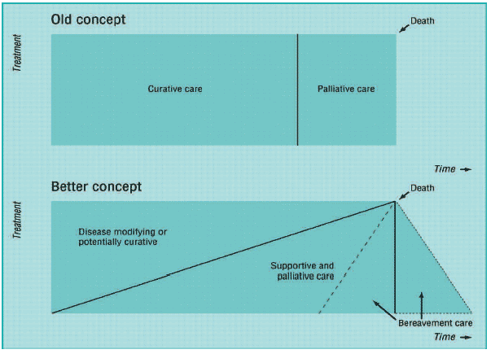
When does palliative care Start?
Murray SA, Kendall M, Boyd K, Sheikh A. Illness trajectories and palliative care. BMJ. 2005; 330:1007-1011

Slide 14
Early referral
Evidence has shown that the introduction of palliative care services early in the course of advanced cancer improves a number of salient outcomes, such as quality of life, symptom burden, mood, and use of health care services
Increasing evidence supports offering concurrent palliative care and standard oncologic care at the initial diagnosis of advanced NSCLC and should be considered for any patients with metastatic cancer early in the course of disease.

Slide 15
Palliative care in Africa
Zimbabwe's Island Hospice Service (founded in 1979) considered to be the first in a developing country
South Africa 1980
Nairobi 1990
Pioneered by Hospice Africa Uganda in Kampala (started 1993)
161 services in 17 countries (out of total 56 countries,2006 data)
• African Palliative Care Association (APCA) founded 2003:
‘To promote and support affordable and culturally acceptable palliative care throughout Africa’

Slide 16
Palliative Care in Malawi
2002 first palliative care team in paediatric department in QECH
2006 First Hospice Ndi Moyo Salima
Current Situation:
5 palliative care centers of excellence
Lighthouse, Lilongwe
Palliative Care Support Trust, QECH (Adult & Paediatirc)
Ndi Moyo, Salima
Bangwe Palliative Care Project
St Gabriels Family centered hospice (inpt & community based)

Slide 17
Palliative Care - Challenges
Widespread lack of understanding of what palliative care actually is and its corresponding benefits
Often perceived to be synonymous with end of life care, death and hospice, or as a means of relief for physical pain exclusively
Lack of training and awareness of palliative care among health professionals is a major barrier to improving access
Overly restrictive regulations for morphine and other essential controlled palliative medicines deny access to adequate pain relief and palliative care in developing countries

Slide 18
Opioid access
Improved access to oral morphine is mandatory for the treatment of moderate to severe cancer pain, suffered by over 80% of cancer patients in terminal phase
WHO

Slide 19
Palliative Care Malawi – Challenges
Provision of palliative care is “patchy”
Limited drug availability including consistent opioid stocks
Limited chemotherapy provision
No available radiotherapy
Resource limitations and poor infrastructure
Late presentation or diagnosis
Inadequate diagnostic skills and assessment

Slide 20
Palliative Care Malawi- Strengths
Integrated palliative care in the HIV and AIDS national health policy
National palliative care guidelines(2011) and national policy (2014)available
Palliative care is integrated in the curricula of health professionals
Has developed and are implementing a palliative care national training package

Slide 21
The worldwide need for palliative cancer care to relieve the suffering of patients and families living with cancer is greater than ever
The importance of palliative care is being emphasized by the WHO Global Action Plan for the Prevention and Control of Noncommunicable Diseases 2013–2020 and the most recent WHO essential medicines list that includes a specific section on medicines for palliative care.

Slide 22
In Conclusion
Palliative care for cancer patients has been shown to bring many benefits in regard to symptom burden; physical, psychological and spiritual.
It is clear that there is an unmet need among patients in Malawi
Therefore improved access and availability of palliative care is essential in order to provide holistic care
Integration of palliative care into existing health care systems is essential

Slide 23
Lucy Finch, Founder Ndi Moyo, Salima

Slide 24
Palliative CAre

Slide 25
Thank you
“You treat a disease you win, you lose. You treat a person I guarantee you will win no matter what the outcome.”
Patch Adams

