Slide 1
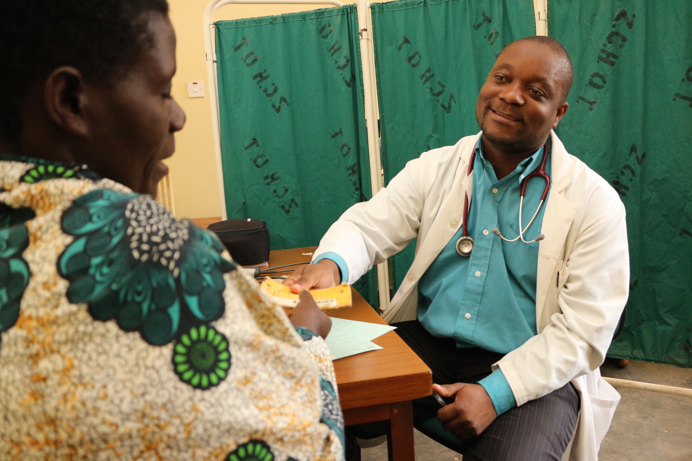
Integrating Cancer care into HIV care
Tisungane clinic
Zomba Central hospital

Slide 2
Kaposis sarcoma
Clinic integrated in ART clinic
791 patients cumulatively enrolled since 2004
Vincristine and bleomycin as per national protocols

Slide 3
KS clinic – enrollment of new patients
 | April 2016 | May 2016 | June 2016 | Total
Monthly Attendants | 140 | 157 | 130 | 427
New | 3 | 10 | 11 | 24
Retreatment | 1 | 4 | 1 | 6
Defaulter | 0 | 2 | 0 | 2
Death | 0 | 0 | 0 | 0

Slide 4
Retrospective analysis (2004 to 2011) of patients with KS at Zomba Central
18 800 HIV-infected adults (> 15 years)
545 with KS (3%)
58% male, median age 33 years
baseline CD4 count - 180 cells/µl

Slide 5
Treatment completion rates and outcomes

Slide 6
Survival curves for HIV infected patients with KS on ART and vincristine
Survival probability
(229 patients - at least one course of VCR) - 65% at 1 year, - 42% at 2 years - 13% by 6 years Patients who started VCR therapy before or concurrently with ART had a higher risk of death and loss to follow-up than those who started VCR after ART.

Slide 7
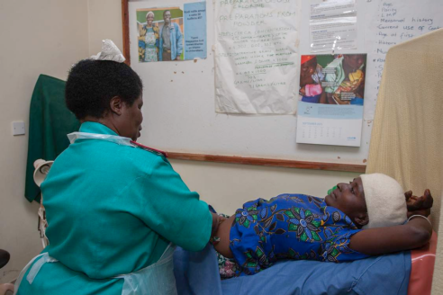
Cervical cancer screening
All women 21 to 65 years asked if had VIA.
In registration area as part of BP and DM screening
If none in past 3 years – then referred for VIA
VIA offered same day or another day
Started in Oct 2015 as part of integrated NCD HIV clinic

Slide 8
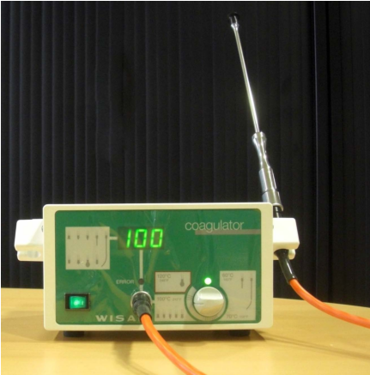
Effect of cold coagulator

Slide 9
Cervical cancer screening at Tisungane clinic

Slide 10
Total cervical cancer screening Zomba Central hospital (HIV pos and neg)
Jan to July 2016
Total VIA – 1537 Initial VIA - 1234

Slide 11
HIV clinic cervical cancer screening Tisungane clinic
May to July 2016
Total VIA – 182

Slide 12
District scale up – current status
Mangochi DH, 2 providers,
2 days per week
Cryo recently repaired
Machinga DH, 7 providers
1 day per week
Cryo broken
Balaka DH, 5 providers
1 day per week
Cryo working
Phalombe HC, 4 providers
2 days per week
Cryo broken
Mulanje DH
5 providers
5 day per week cryo working

Slide 13
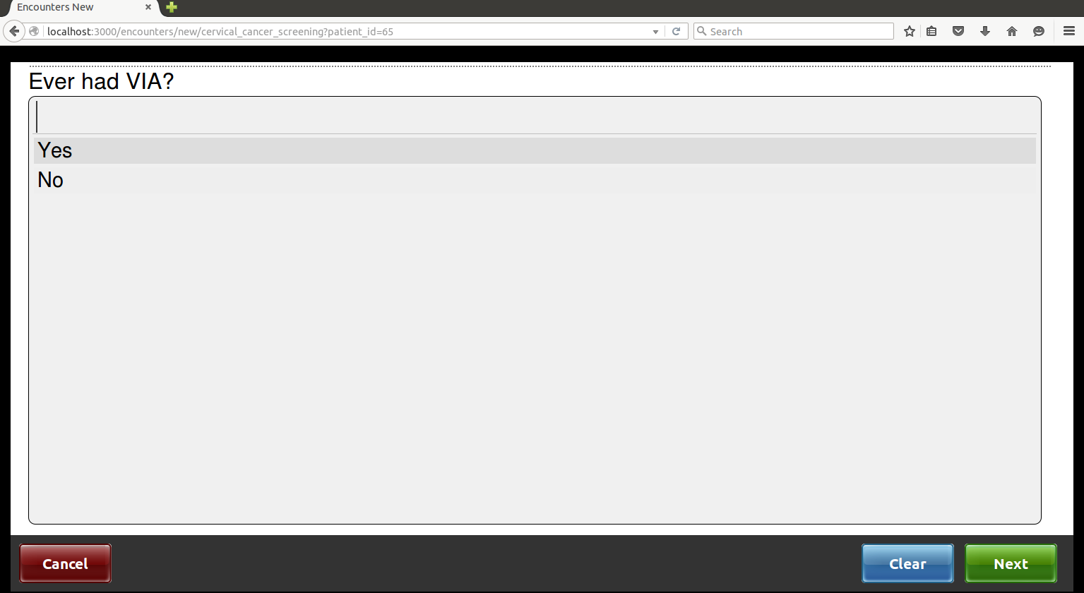
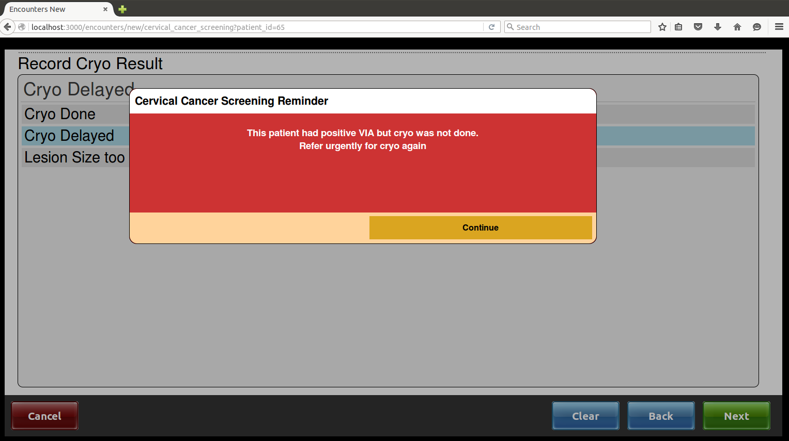
Integrated VIA module developed for BART 2 – with Baobab
To be piloted in Zomba Central this month

