Slide 1
KAPOSI SARCOMA
Agnes Moses/Joe Gumulira
UNC PROJECT, LIGHTHOUSE, KCH, COM, U54MCC

Slide 2
BACK GROUND
Kaposi's sarcoma (KS) is a low-grade vascular tumor associated with infection with Human Herpes Virus-8, also known as the Kaposi Sarcoma Herpes Virus(KSHV).
Kaposi sarcoma (KS) is the most common cancer in HIV-infected persons .
Apart from KS ,KSHV also causes MCD and primary infusion and has a prevalence rate ranging from 35% to 50% of HIV-infected persons in SSA[1].
AIDS-related KS has a variable clinical course, ranging from minimal disease presenting to a rapidly progressing neoplasm that can result in significant morbidity and mortality.

Slide 3
Globally
The modern ART era in the US and Europe has seen to marked declines in KS incidence due to ART.
KS incidence rate in HIV-infected persons can be reduced by 70% to 90% if the HIV-infection is treated with antiretroviral therapy (ART)[10].
Combined efforts of early testing and treatment are initiation of ART are necessary elements in reducing risk for KS.

Slide 4
Africa
Data from Uganda and Zimbabwe have also demonstrated declining KS incidence since ART became available[1].
KAART trial done in Durban/RSA in the ART era demonstrated similar overall survival at one year for HIV-infected patients with advanced KS treated with ART plus chemotherapy (ABV; doxorubicin, bleomycin, vincristine) compared with ART alone [Mosam et al].
However tumor response was better in the chemotherapy group.

Slide 5
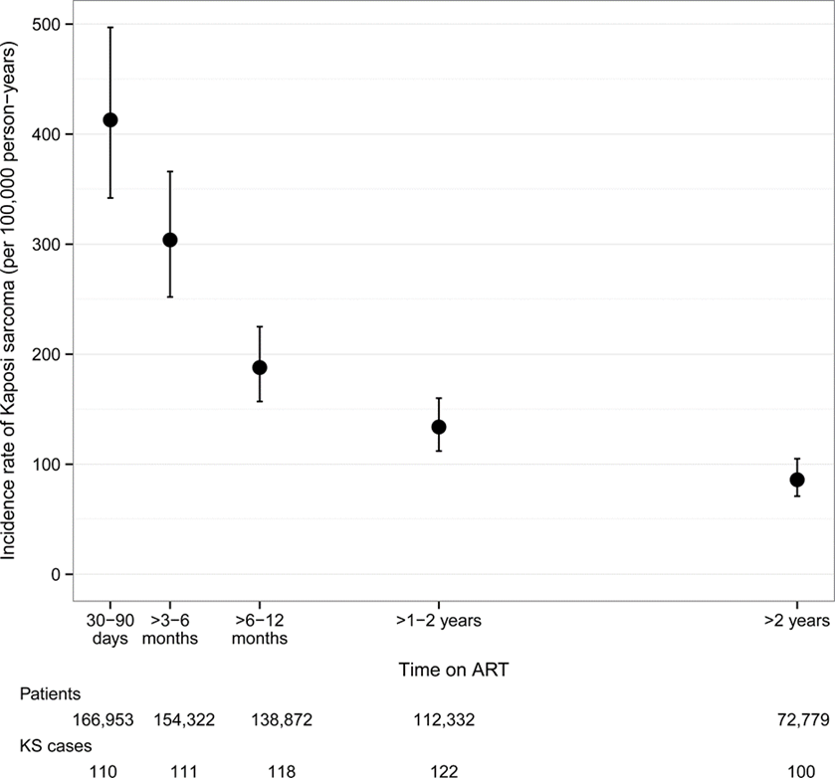
KS Incidence from Meta analysis of Seven Cancer Registries in SSA ART era
Rohner E. etal;J Acquir Immune Defic Syndr. 2014 December 15; 67(5): 547–554.

Slide 6
KS Facts- Malawi
Kaposi Sarcoma (KS) contributes 35% or more of all cancers in Malawi.
It is the commonest cancer among HIV infected People.
Its incidence continues to increase despite wide spread ART .
Little research data on Treatment strategies
No prior relevant local RCT to inform evidence based treatment strategies

Slide 7
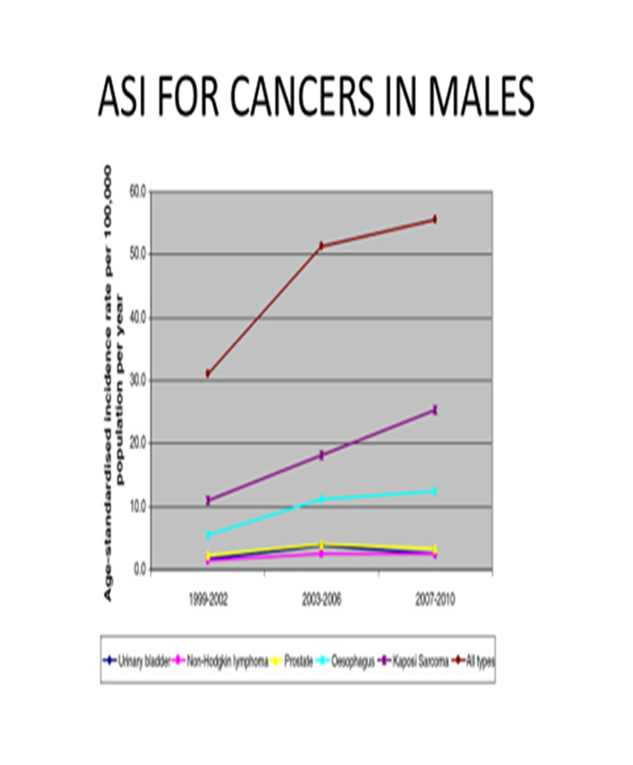
Source:Msyamboza et al;BMC Res Notes. 2012; 5: 149.

Slide 8
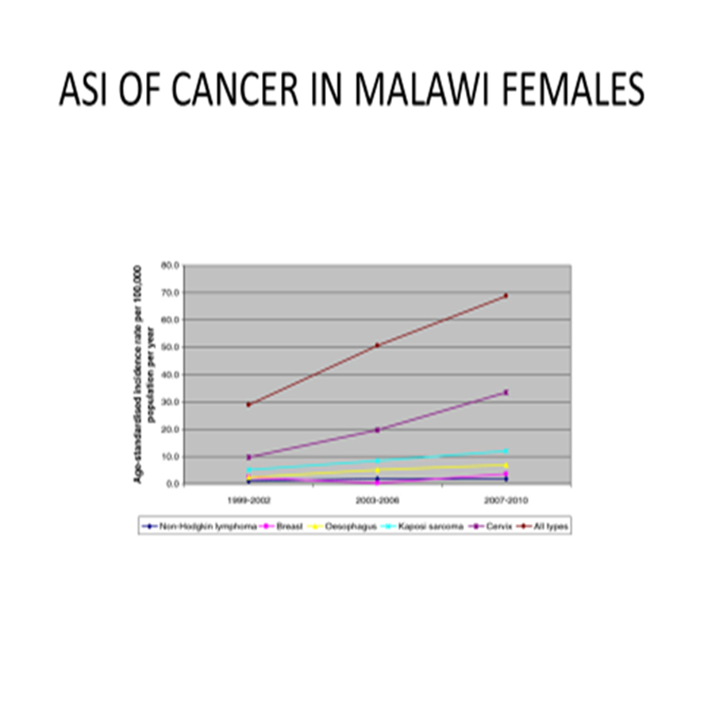
Source:Msyamboza et al;BMC Res Notes. 2012; 5: 149.

Slide 9
KS highly associated with HIV Infection
Type of Cancer: Source KCH, CANCO Study Unpublished Results

Slide 10
KS Burden(KCH+Lighthouse Registry)
KCH Cancer registry record a mean of 200 new cases per year though decline has been observed since 2013
Most Cases(85%-87%) are T1 Stage
97 % are HIV positive
75% are between aged between 25-50
Male preponderance

Slide 11
KCH/LH REGISTRY KS CASES

Slide 12
KS Cases by age and Gender

Slide 13
KS - Management
Goals of treatment
symptom palliation,
prevention of disease progression,
shrinkage of tumor to alleviate edema, organ compromise, and psychological stress [5].

Slide 14
KS - MANAGEMENT
Systemic treatment ART is recommended for all patients with AIDS-related KS [5-8].
Treatment beyond ART should depend upon the extent of disease, the rapidity of tumor growth, the HIV-1 viral load, the CD4 cell count, and the patient's overall medical condition [9].
Notes:
A French database study that included 54,999 patients with over 180,000 patient years of follow-up found that the incidence rate for new cases of KS fell from 32 per 1000 person-years in 1993-1994 to 3 per 1000 person-years after 1999 [10]. Furthermore, the incidence of visceral involvement at presentation fell from more than 50 percent to less than 30 percent. Similar dramatic decreases have been seen in other studies [11,12].

Slide 15
Local treatment approaches
Intra lesional chemotherapy — Vinblastine is the most widely used agent.
Radiation therapy
Topical alitretinoin
Notes:
It can be injected directly into a KS lesion as a 0.2 to 0.3 mg/mL solution with a volume of 0.1 mL per 0.5 cm2 of lesion. Multiple injections may be necessary for larger lesions. A second series of injections is often necessary three to four weeks later. Treated lesions will fade and regress although typically not resolve completely [23-25]. In one series of 42 patients with oral KS, for example, 74 percent showed more than a 50 percent reduction in lesions; palliation was achieved for a mean of 4.3 months [23]. . Although discomfort from radiotherapy is frequent, it usually resolves within two weeks of treatment. Radiation therapy does not have a role in patients with extensive KS, as was illustrated by a randomized trial from Zimbabwe [27]. In this trial, radiation therapy did not improve either quality of life or survival compared to supportive care alone in 495 patients who were not treated with antiretroviral drugs.
This agent is rarely used, since the topical gel can cause inflammation and lead to pigmentation changes in dark-skinned patients. In two phase III studies involving 402 patients, alitretinoin was associated with a shorter time to response, a longer duration of response, and a longer time to disease progression compared to a placebo vehicle gel [28,29]. In these trials, responses were seen in 35 and 37 percent of patients after 12 weeks of treatment, compared to 7 and 18 percent with placebo. Responses were seen in patients with a wide range of baseline CD4+ lymphocyte counts.

Slide 16
Systemic Treatment
Systemic chemotherapy is generally used for patients with more advanced KS or when there is evidence of rapid disease progression [6,8].
Pegylated liposomal doxorubicin generally recommended as the first-line treatment for KS in resource rich settings[6].
Other agents that have been used include paclitaxel, bleomycin, vinblastine, vincristine, and etoposide.

Slide 17
Experimental approaches
●Imatinib — Activation of the platelet-derived growth factor (PDGF) and c-kit receptors (both receptor tyrosine kinases) are important in the growth of KS lesions and imatinib inhibits both of these receptors.
●Inhibitors of mTOR pathway — Rapamycin and temsirolimus are inhibitors of the mechanistic target of rapamycin (mTOR)
●Bevacizumab — Bevacizumab is a monoclonal antibody directed against vascular endothelial growth factor, which contributes to the pathogenesis of KS.
●Vitamin D and its analogs — Primary KS tumors and cell lines derived from KS lesions express high levels of the vitamin D receptor. In one report, treatment with 1, 25 dihydroxyvitamin D3 inhibited the growth of KS cells in vitro and in xenograft models
Notes:
Imatinib:. In a multicenter phase II study, 30 patients were treated with imatinib for up to 12 months [56]. Patients with symptomatic visceral disease requiring chemotherapy were excluded. Antiretroviral therapy was permitted but not required. Partial responses were observed in 10 patients (33 percent). Treatment was generally well tolerated and nine patients completed the full year of treatment.
Rapamycin. The demonstration of patients who had regression of their transplant-related KS when treated with rapamycin indicates that the PI3K/AKT/mTOR pathway may be important in the pathogenesis of KS [57]. In another study, seven patients with HIV-related KS were treated with a combination of rapamycin plus antiretroviral therapy [58]. Three patients, all on protease inhibitor containing regimens, had a partial response of their KS to treatment.
;

Slide 18
Miscellaneous agents
Angiogenesis inhibitors fumagillin and thalidomide .
Anti-HHV-8 therapy :However, there are no specific anti-HHV-8 therapies available.
Additional studies will be required to determine the role of these experimental therapies in KS patients

Slide 19
Current Treatment Practices in Malawi
Limited stage T0 Disease ART/ ART plus vincristine monotherapy
T1 Disease, Chemotherapy: BV/ABV as first line.
Paclitaxel reserved as secondline treatment
Radiation therapy external referral, where indicated

Slide 20
KS RELATED RESEARCH,
IN MALAWI
WHERE ARE WE?

Slide 21
KS Related research
No previous randomised Clinical Trials done before 2011.
Only Complete Clinical trial in SSA in Durban(KAART)
Previous trials were retrospective cohorts

Slide 22
Past studies in Malawi - AMCs 001(KSHV Viral profiles)
70 patients
66 full analysis
Finding
existence of KS subtypes defined by KSHV transcription which could be targets for antiviral treatment

Slide 23
Past Cohorts studies in Malawi
Herce et al, demonstrated the feasibility of providing standard-of-care chemotherapy in setting of HIV treatment to treat HIV-KS in rural Malawi(NENO)
Mwafongo et al, evaluated treatment outcomes at LH clinic for vincristine monotherapy versus Bleomycin and Vincristine(BV);

Slide 24
Current KS Research Studies-1
Malawi through UNC Project and Johns Hopkins University are participating in two ongoing multinational studies co-sponsored by the AIDS Clinical Trials Group (ACTG)and AIDS Malignancy Consortium(AMC) are evaluating treatment strategies for two KS Clinical Stages.

Slide 25
CURRENT KS research Studies-2
A5264/AMC067 - A Randomized Evaluation of Antiretroviral Therapy Alone or with Delayed Chemotherapy versus Antiretroviral Therapy with Immediate Adjunctive Chemotherapy for Treatment of Limited Stage AIDS-KS in Resource-Limited Settings (REACT-KS;This limited KS trial was comparing ART alone to ART plus oral etoposide and is closed to accrual.

Slide 26
Challenges
What are optimal strategies for treating KS

Slide 27
Current KS research Studies-3
A5263/AMC 066 - A Randomized Comparison of Two Regimens of Chemotherapy with Compatible Antiretroviral Therapy for Treatment of Advanced AIDS-KS in Resource-Limited Settings
This Advanced KS trial is comparing ART for all patients with intravenous paclitaxel, or intravenous bleomycin plus vincristine.
Results from both studies will inform evidence based treatment guidelines.

Slide 28
Current KS research Studies-4
KS Project:Investigating chemotherapy treatments, response and subsets of HIV-associated Kaposi sarcoma in Malawi to be jointly conducted by Light house and UNC project, will characterize clinical and biological subsets of HIV + KS patient.
Result will provide information that will help tailor KS treatment to the patient for population level benefit.

Slide 29
Studies summary
STUDY(YEAR) | SUBJECTS CATEGORY | STATUS & No ENROLLED | FINDINGS
AMC 001(2013) | T0 and T1 | Completed 66 | Distinct KS subsets BV more responses than vinc monotherapy
AMCO67/ACTG A5264(2011-2016) | T0 | Ongoing | NA/
AMC 066/ACTG A5263 (2013-date) | T1 | Ongoing58 | N/A
LCC1424/KS PROJECT(2016-2018) | PENDING | Not Open | N/A

Slide 30
KS Key points
Important contributor of cancer burden overall
Major contributor of HIV+ cancers
Primary prevention of HIV
Early initiation of ART
Tailoring treatment depending on clinical and biological subset.
Introduction of newer and safer agents
Locally generated evidence urgently required

Slide 31
References
1.Moore PS, Chang Y. Detection of herpesvirus-like DNA sequences in Kaposi's sarcoma in patients with and without HIV infection. N Engl J Med 1995; 332:1181.
2.Beral V, Peterman TA, Berkelman RL, Jaffe HW. Kaposi's sarcoma among persons with AIDS: a sexually transmitted infection? Lancet 1990; 335:123.
3.Stefan DC, Stones DK, Wainwright L, Newton R. Kaposi sarcoma in South African children. Pediatr Blood Cancer 2011; 56:392.
4.Senba M, Buziba N, Mori N, et al. Increased prevalence of Kaposi΄s sarcoma-associated herpesvirus in the Kaposi΄s sarcoma-endemic area of western Kenya in 1981-2000. Acta Virol 2011; 55:161.
5.Iscovich J, Boffetta P, Winkelmann R, et al. Classic Kaposi's sarcoma in Jews living in Israel, 1961-1989: a population-based incidence study. AIDS 1998; 12:2067.
6.Fenig E, Brenner B, Rakowsky E, et al. Classic Kaposi sarcoma: experience at Rabin Medical Center in Israel. Am J Clin Oncol 1998; 21:498.
7.Lodi S, Guiguet M, Costagliola D, et al. Kaposi sarcoma incidence and survival among HIV-infected homosexual men after HIV seroconversion. J Natl Cancer Inst 2010; 102:784.
8.Ledergerber B, Telenti A, Egger M. Risk of HIV related Kaposi's sarcoma and non-Hodgkin's lymphoma with potent antiretroviral therapy: prospective cohort study. Swiss HIV Cohort Study. BMJ 1999; 319:23.
9.International Collaboration on HIV and Cancer. Highly active antiretroviral therapy and incidence of cancer in human immunodeficiency virus-infected adults. J Natl Cancer Inst 2000; 92:1823.
10.Grabar S, Abraham B, Mahamat A, et al. Differential impact of combination antiretroviral therapy in preventing Kaposi's sarcoma with and without visceral involvement. J Clin Oncol 2006; 24:3408.
11.Franceschi S, Maso LD, Rickenbach M, et al. Kaposi sarcoma incidence in the Swiss HIV Cohort Study before and after highly active antiretroviral therapy. Br J Cancer 2008; 99:800.
12.Mocroft A, Kirk O, Clumeck N, et al. The changing pattern of Kaposi sarcoma in patients with HIV, 1994-2003: the EuroSIDA Study. Cancer 2004; 100:2644.
13.Gill J, Bourboulia D, Wilkinson J, et al. Prospective study of the effects of antiretroviral therapy on Kaposi sarcoma--associated herpesvirus infection in patients with and without Kaposi sarcoma. J Acquir Immune Defic Syndr 2002; 31:384.
14.Gallafent JH, Buskin SE, De Turk PB, Aboulafia DM. Profile of patients with Kaposi's sarcoma in the era of highly active antiretroviral therapy. J Clin Oncol 2005; 23:1253.
15.Sgadari C, Barillari G, Toschi E, et al. HIV protease inhibitors are potent anti-angiogenic molecules and promote regression of Kaposi sarcoma. Nat Med 2002; 8:225.
16.Martinez V, Caumes E, Gambotti L, et al. Remission from Kaposi's sarcoma on HAART is associated with suppression of HIV replication and is independent of protease inhibitor therapy. Br J Cancer 2006; 94:1000.
17.Krown SE, Lee JY, Dittmer DP, AIDS Malignancy Consortium. More on HIV-associated Kaposi's sarcoma. N Engl J Med 2008; 358:535.
18.Bower M, Nelson M, Young AM, et al. Immune reconstitution inflammatory syndrome associated with Kaposi's sarcoma. J Clin Oncol 2005; 23:5224.
19.Leidner RS, Aboulafia DM. Recrudescent Kaposi's sarcoma after initiation of HAART: a manifestation of immune reconstitution syndrome. AIDS Patient Care STDS 2005; 19:635.
20.Letang E, Lewis JJ, Bower M, et al. Immune reconstitution inflammatory syndrome associated with Kaposi sarcoma: higher incidence and mortality in Africa than in the UK. AIDS 2013; 27:1603.
21.Achenbach CJ, Harrington RD, Dhanireddy S, et al. Paradoxical immune reconstitution inflammatory syndrome in HIV-infected patients treated with combination antiretroviral therapy after AIDS-defining opportunistic infection. Clin Infect Dis 2012; 54:424.

Slide 32
Acknowledgement
Data team , UNC, LH.
Cancer Interest Group
Organisers of MCC symposium
U54 PI.

